Slide 1
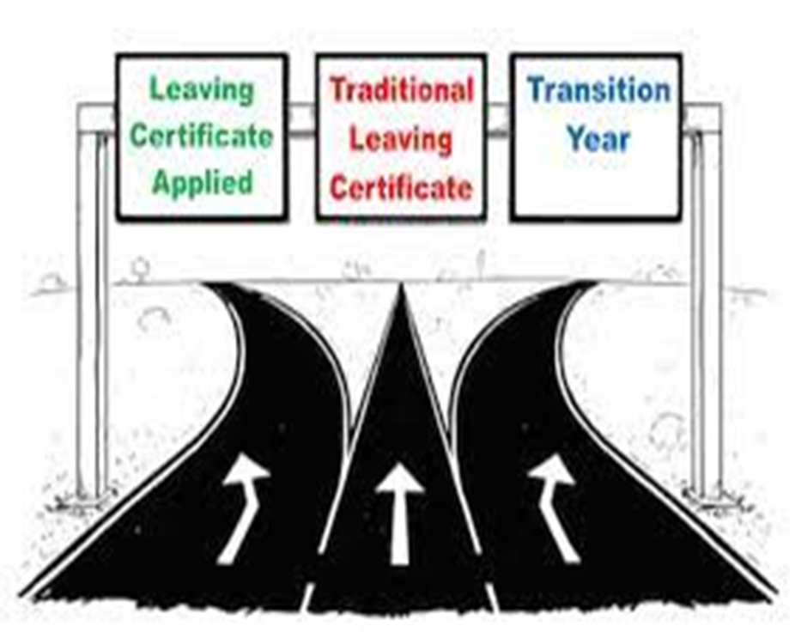
Senior Cycle Options
Junior Cycle
OR
OR
Transition Year
5th Year
LCA 5th year
5th Year
6th Year
LCA 6th year
University/ Technological University/ PLC/ Apprenticeship/ Work
PLC/ Apprenticeship/ Work
6th Year

Slide 2
Transition Year (Ms Cunningham TY Coordinator)
A unique one year programme
A bridge enabling you to make the transition from the dependent learning at Junior Cycle to the independent learning associated with senior cycle
It encourages personal and social development and supports independent growth
Core Subjects
ICT
Sample Subjects
Work Experience
Continuous Assessment
Drama
Young Scientists
GAA Future Leaders
Junk Kouture
Educational Trips
Workshops
Gaisce
Cairde
First Aid
Road Safety
Express interest
Complete form
Apply
“It is only worthwhile if you get involved and make every moment count”

Slide 3
Leaving Cert. Applied (Ms Cunningham LCA Coordinator)
A distinct 2 year Leaving cert. Programme aimed at preparing you for adult and working life
Provides opportunities to develop personal responsibility and self-esteem
Focuses on the talents of each student and helps students apply what they learn to the real world
Removes the pressure of exam focused grades through Key Assignments & Tasks
Practical Based learning with applications to the world of work & Work Experience built in
Opens opportunities to enter PLCs, Apprenticeships, Traineeships or employment
Self-discipline important:
4 x half year blocks ‘Sessions’
90% attendance is essential
Preparation for Work
Work Experience
Enterprise
Communications
Art
Social Education
French
Irish
Maths
Information Technology
Agriculture/ Horticulture Technology
Engineering
Office Skills
Construction
Craft & Design
Hotel Catering
Community Care
“An active programme that allowed me greater independence and opportunities to connect with the world of work without the pressure of complete exam focus”

Slide 4
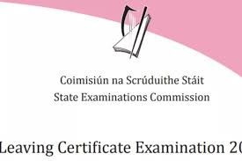
Leaving Cert. Established
2 year academic programme studying 7 subjects at HL/ OL
FL maths is available however it may have college implications
Assessment is through terminal exam (some subjects offer practical elements)
You would benefit from the LC if you enjoy learning, feel at ease with the structure of the junior cycle, would like to progress to college/ university

Slide 5
LC Subject Choice getting the right mix will affect your future
Choose favourite subjects. If you enjoy the subject, you will excel at it. You could boost your ability by choosing subjects which compliment each other i.e. biology and agricultural science.
Support informed decisions by talking to subject teachers/ senior students, examine text books (most available online), use qualifax/careersportal, use results from aptitude and ability tests (CAT4).
Take into account future college/career paths & ensure your choices meet college entry requirements.

Slide 6
Do | Don’t
Choose subjects you enjoy | Choose a subject because your friend is taking it
Choose subjects you’re good at | Choose a subject because you like/dislike the teacher
Choose subjects you need for your chosen career | Choose a subject because you think it will be easy
Keep your options open for the future by making a balanced choice now | Choose a new subject without finding more about it.
Talk to your Guidance Counsellor and your teachers | Make a decision at the last minute without thinking about it
Talk to your parents/guardians | Don’t panic

Slide 7
Consequences of poor subject choice
Poor subject Choice:
Increases the risk of being unhappy within a subject for two years which ultimately leads to poor motivation
Increases the risk of not performing to full potential - may impact on overall attainment/ points
Increases the risk of not studying a subject required for course of choice
Making subject/class changes throughout fifth year causes disruption to study as you attempt to catch up on the curriculum covered

Slide 8
Factors to consider when making Subject & level Choices It’s NOT all about the Points!
The subjects & Levels needed for a particular college i.e matriculation or minimum entry requirements
The subjects needed for a particular course i.e specific subject requirement
The subjects useful for a particular course
Institution | Minimum grades | Required subjects
NUI Colleges: UCD, MU, UG, UCC, RCSI, Shannon College of Hotel Mgmt. | 2H5 + 4O6/H7 (Level 8) | O6 in English, Irish and Third language*
Trinity College Dublin | 3H5 + 3O6/H7 (Level 8) | O6 in Maths, English & another language
Dublin City University | 2H5 + 4O6/H7 (Level 8) | O6 in Maths, English or Irish
University of Limerick | 2H5 + 4O6/H7 (Level 8) | O6 in Maths, English & Irish or another language
Technological Universities | 2H5 + 4O6/H7 (Level 8) Level 7 courses require 5O6/H7 | O6 in Maths, English or Irish
There are some course exceptions, e.g., specific requirement for Primary Teaching in DCU – H4 Irish. Engineering at UG – H4 Maths |  | e.g specific requirement for Primary Teaching in DCU – H4 Irish. Engineering at UG – H4 Maths

Slide 9
CAO Points are calculated from your 6 Best Subjects
Your choice of level for Maths deserves due consideration – the 25 bonus points reward students for the time, effort & determination it demands

Slide 11
Leaving Certificate Subjects offered at Borrisokane CC
Compulsory Subjects
Irish
Maths
Practical Group
Construction Studies
Engineering
Science Group
Ag Science
English
Design & Communication Graphics (compliments the artistic group)
Biology
Chemistry
Physics
Computer Science
Artistic & Creative Group
Art
Music
Languages Group
French
German
Humanities & Social Group
History
LC Physical Education
Geography
Home Economics
Business Group
Business
Accounting
LCVP

Slide 12
Practical Group
These subjects are 'hands-on' and involve working with tools and machinery on physical things like wood, metals and plastic. They may involve designing, planning and building things.
Construction Studies
Engineering
Design Communication Graphics

Slide 13
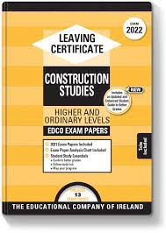
Leaving Certificate Construction Studies
What is covered? Heritage & Conservation / Planning / Sustainability / Energy Conservation Site Safety / Masonry &Timber Frame Construction Plumbing & Drainage / Heat Retention / Electricity
Examination: Written Exam: 50% Course work submitted at Easter: 25% Practical bench test in May: 25% All practical skills learned in JC carry forward. Theory in LC is not related to JC MTW so can be a fresh start.
Careers/Courses: Sustainable Energy Consultant, Civil Engineering, Mechanical Engineering, Construction Management, Architecture, Quantity Surveyor, Site Foremen, Plumber, Carpenter, Joiner.

Slide 14
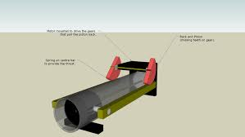
Leaving Certificate Engineering
What is covered? Workshop Processes: Health and safety / Benchwork / Heat treatment of metals / Plastics processing / Fabrication and finishing of metals / Machining / Technology. Materials and Technology: Classification and origin of metals / Structure of metals / Iron and steel / Non-ferrous metals / Corrosion of metals / Materials testing / Plastics / Joining of materials / Machining / Metrology / Manufacturing processes.
Examination: Written Exam:50% Course work: a project 25% & a one-day practical test in early May 25% (40%/30%/30% for ordinary level)
Careers/Courses: Agricultural Engineering, Aircraft Technician, Fitter/Turner, Industrial Design / Operatives, Mechanics, Mechanical Production, Motor Mechanic, Structural and Civil Engineer, Toolmaker and Welder

Slide 15
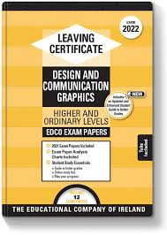
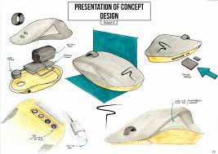
Leaving Certificate Design and Communication Graphics
What is covered? DCG involves visualizing and understanding information presented verbally or graphically. Drawings and designs (2D / 3D) are prepared using sketching, traditional drafting equipment and Solidworks.
Examination: Written Exam:60% Course work submitted at February: 40% of which CAD (Solid Works) will form a significant component.
Careers/Courses: Civil Engineering, Mechanical Engineering, Construction Management, Architecture, Product Design, Quantity Surveyor, Draughtsman, Graphic Design and Teaching.

Slide 16
Science Group
These subjects demonstrate how to explore nature using carefully planned methods, and teach the basic methods and findings of scientific investigation.
Agricultural Science
Biology
Chemistry
Physics
Computer Science**
LC PE**
**(Considered a science subject for a number of specific/related courses- NOT lab sciences)
Holding on to one Science subject for Senior Cycle (Biology, Physics, Chemistry, Agricultural Science) keeps several college options open including all Healthcare courses, most Science courses, Sports & Physical Education and Engineering courses.

Slide 17
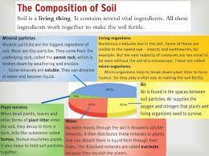
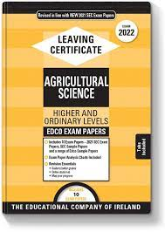
Leaving Certificate Agricultural Science
What is covered? Soils/plants/farm crops - cereal/roots/grassland/trees & shelter. Structure and function of the animal body – the cow, the sheep, horse, and pig. Farm buildings and farm-house environment.
Examination: Written examination: 75% Project/Coursework: 25% The Project – (i) portfolio of activities and investigations, including laboratory and field investigations, farm visits and other appropriate activities. (ii) a student project, through which a topic of agricultural significance is explored in greater depth. This will be based on a theme, which will be set annually by the State Examinations Commission.
Careers/Courses: Agricultural Engineering, Inspector, Animal Breeder, Animal Trainer, Butter/Cheese-maker, Creamery Manager, Dairy Scientist, Farmer, Fish Farmer, Forester, Horticulturalist, Lab Technician, Stud Farm, Veterinary Surgeon

Slide 18
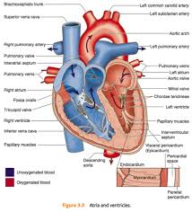
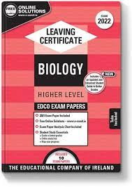
Leaving Certificate Biology
What is covered? 1.The study of Life : Scientific Method, Characteristics of Life, Ecology, Nutrition. 2.The Cell: Structure, Diversity, Continuity, Metabolism, Genetics. 3.The Organism: Diveristy, Organisation, Transport & Nutrition, Breathing, Excretion, Responses, Reproduction & Growth.
Examination: Written Exam (60%) Biology in Practice Investigation (40%) The course is long. Students need to like learning off information.
Careers/Courses: Nursing, Beautician, Health Professionals, Marine Biology, Food Industry, Environmental Officers

Slide 19
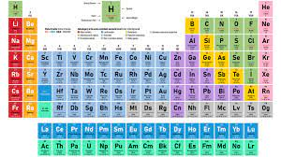
Leaving Certificate Chemistry
What is covered? Periodic Table and Atomic Structure, Chemical Bonding, Stoichiometry, Formulas and Equations, Volumetric Analysis Fuels and Heats of Reaction, Rates of Reaction, Organic Chemistry, Chemical Equilibrium, Environmental Chemistry: Water and Options: Industrial and Atmospheric or Metals and Electrochemistry. A mixture of theory (definitions), calculations and 28 mandatory experiments and demonstrations. Must start learning immediately in 5th year as you can get lost easily. Must be logical, analytical, numerate and creative.
Examination: Written Exam 60% Chemistry in Practice Investigation 40%
Careers/Courses: Medicine, Dentistry, Science & Engineering

Slide 20
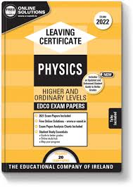
Leaving Certificate Physics
What is covered? Nature of Science, Mechanics, Temperature, Heat, Waves, Vibrations and Sounds, Light, Electricity and Modern Physics. Covers a good mixture of theory (definitions), calculations and mandatory experiments (24). A lot of maths involved.
Examination: Written Exam (60%) Physics in Practice Investigation (40%)
Careers/Courses: Renewable Energy, Environment and Climate, Communications, Music and Television, Sports and Games (without Physics there would be no iPads, games consoles or the internet!!), Transport, Medicine, Education

Slide 21
Leaving Certificate Computer Science **
What is covered? Computer Science is the study of algorithms and programming, and the impact computers have on society. Assessment Learning Tasks (ALTs): Students will perform 4 ALTs over the course of the two years. These are practical projects in which students learn the applications of what they have learned. What will students learn: Computational Thinking, Programming languages, Design and Collaboration, Computers and Society, How to build and design websites, Number Systems, Embedded Systems (like micro:bit)
Examination: 70% end of course examination: 38% - written & 32% - computer based 30% individual final year course work
Careers/Courses: Computers, ICT, gaming, programming, cyber security, cloud computing

Slide 22
Artistic & Creative Group
These subjects involve developing creativity and the appreciation of the work of others. This involves learning the methods and techniques of the subject and producing your own work using these skills.
Art
Music

Slide 23
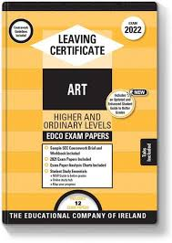
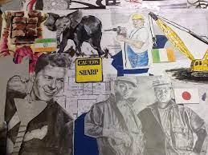
Leaving Certificate Art
What is covered? Life Drawing Craft or Design Still Life or Imaginative Composition History and Appreciation of Art. Encourages creative thinking (INNOVATION) and critical analysis (PROBLEM SOLVING) Don’t need to have done Art for Junior Cert. Portfolio preparation not part of course.
Examination: Project over 6-8 weeks on a topic decided by the state exams (50%) Practical exam: Life drawing (20%) Art History exam (30%) in June: (2.5 hs)
Careers/Courses: Advertising, Animation, Architecture, Archaeology, Art Worker, Art Therapy, Fashion and Textile Design, Film Making, Graphic Design, Interior Design, Photography, Theatre Design, Product Design, Web Design... Endless list of careers that reward creativity and innovative thinking.

Slide 24
Leaving Certificate Music
What is covered? The course is divided into 3 components: Performing 50% Performing is fundamental therefore to the course and classwork Composing 25% This involves learning about the rudiments and Basic theories of Music. The students learn how to Compose a short melody and how to add backing Chords to a piece of Music. Listening 25% This involves analysing four different pieces of Music which includes Music by JS Bach,, Mozart, The Beatles and Queen. The students also study Irish Music and various other styles of Music
Examination: The Practical exam is 50% of the overall mark and each student performs either 6 pieces on 1 Instrument, or 4 + 4 on two different instruments. This exam takes place on the March/April before the Written exams. The written exam is in two parts: The Composing paper and The Listening paper
Careers/Courses: Arranger, performer, teacher, composer, music producer, advertising, sound engineer

Slide 25
Languages Group
It is widely believed that if a student does not study a language for the Leaving Cert they will not be able to attend third level - this is not entirely the case, however the decision to drop a language should not be taken lightly.
Impact of Dropping a Language
Most third level colleges do not require entrants to have a European language in order to meet the matriculation, or minimum entry requirement.
At Trinity College Dublin, students are required to pass English and another language, and Maths or Latin.
The matriculation requirements for DCU are Maths and English or Irish.
UL requires students to have English, Maths and Irish or another language.
So, a student who does not take a foreign language at Leaving Cert will typically meet the entry requirements for these universities, as long as they take Irish, or have an Irish exemption.
NB: NUI Colleges require a MFL for many but not all courses; use Qualifax/Careers Portal to cross check requirements for your course of interest
Exemption from Irish
A student with an Irish exemption may apply for an exemption from the requirement to present Irish as a matriculation subject from the university they will be applying to
The Technological Universities generally expect students to have O6/H7 in English and Maths - not choosing a language should have no impact on a candidate's ability to get place in one of their programmes.
PLC colleges do not require students to have taken a language.
A modern European language will also be required for application to cadetships in the Defence Forces.
So, while not choosing a language will not affect entry to the majority of third level institutions, it will restrict choice to some extent.

Slide 26
Leaving Certificate French & German
What is covered? Three components: Basic Communicative Proficiency Language Awareness Cultural Awareness
Examination: Written Exam: 2.5 hrs (55%). Aural: 30 mins (H.L: 20%; O.L: 25%) Oral: 12/15 mins (H.L: 25%; O.L: 20%) Need a good foundation to do or get honours.
Careers/Courses: European Studies, Marketing, Hotel Management, Translation, EU, Teaching, Cadets, Tourism & Leisure.

Slide 27
Humanities & Social Group
These subjects explore the ways in which humans live and communicate in the world. Human life is examined by looking at our past, our present and into our future. These subjects help people to express themselves clearly and develop their reasoning ability.
These subjects explore common issues faced by all people living in society. They develop the skills and knowledge used to manage personal resources and guide human behaviour.
History
Geography
Home Economics
Physical Education

Slide 28
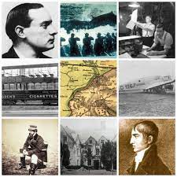
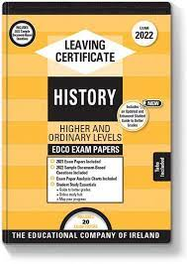
Leaving Certificate History
What is covered? Students cover Modern Irish History and two topics from European history The course is divided into three areas: A research study (20%) – this is pre-submitted March of Leaving Cert. Document based study (20% of the Exam) Three topics (60% of the Exam) - from Irish and European History. Develops critical, analytical and communication skills based around learning about the world of politics, economics, religion, philosophy.
Examination: Written Exam 80% (4 Q’s): 2 hrs 50 mins. Investigation 20% : Extended essay.
Careers/Courses: Politics, Journalism, Local Government, Law, Archaeology, Media, Museum Work, Librarian, Civil Service

Slide 29
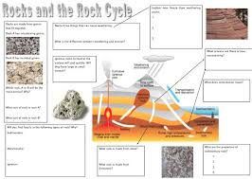
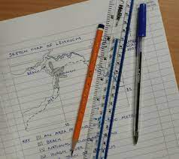
Leaving Certificate Geography
What is covered? 3 Core Units: Physical Environment 2. Regional Geography 3. Investigation and Skills (Fieldwork) 1 of 2 Elective Units: 4. Economic Geography 5. Social Geography 1 of 4 Optional Units: 6. Global Interdependence 7. Geo-Ecology 8. Culture and Identity 9. The Atmosphere
Examination: ➢ Written Exam (HL: 80%; OL: 75%): 2 hrs 50 mins. Short Answer Questions/Multi-Part Questions/Essay (optional HL only) ➢ Fieldwork Project due in April: (HL: 20%; OL:25%) Involves drawing maps, figures, statistics, charts
Careers/Courses: Urban Planning, Map Making, G.P.S. / G.I.S. Environment, Teaching, Demographer, Weather / Climate

Slide 30
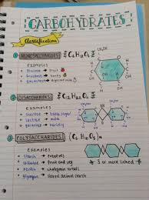
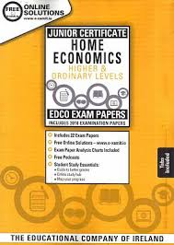
Leaving Certificate Home Economics
What is covered? 3 core areas and 1 elective. Core: Food Studies (45%), Resource Management & Consumer Studies (25%) Social Studies (10%). Electives: 3 of which 1 is chosen (20%): Home Design and Management, Textiles, Fashion and Design (10%) for written and (10%) for Sewing Assignment & Social Studies.
Examination: Written Exam: 80%: 2.5 hours (Core: 60% & Electives: 20%) Practical coursework: 20%
Courses/Careers: Hotel, Catering & Tourism, Culinary Arts, Fashion & Design, Childcare, Home Economics Teaching, Social Care, Food Science

Slide 31
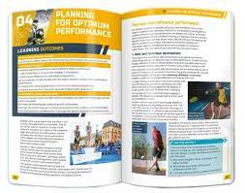
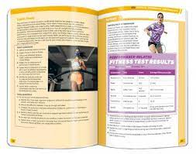
Leaving Certificate Physical Education**
What is Covered? LCPE is the equivalent of studying sports science in first year in college. As the written assessment comprises 50% of the marking, ability in the physical activity alone will not be sufficient, students will need to engage with the classroom section of the course. Theoretical knowledge such as how to analyse skills and improve nutrition, will directly benefit student’s physical performance goals. Course Content: Strand 1 Topics: Learning and improving skill and techniques, Physical and psychological demands of performance, Structures, strategies, roles and conventions, Planning for optimum performance. Strand 2 Topics: Promoting physical activity, Ethics and fair play. In addition two of the following each year: Physical activity and inclusion. Technology, media and sport. Gender & Physical Activity Business & Enterprise in Physical activity & sport
There are three assessment components in LCPE: Physical activity project – 20%. Performance assessment – 30%. Written examination – 50%.
Career Sectors This subject builds skills and knowledge that are particularly useful for careers in the following Career Sectors: sports and fitness occupations, Physiotherapy, physical training or sports coaching, Strength & Conditioning.

Slide 32
Business Group
These subjects teach the skills and knowledge needed to understand how business works.
Accounting
Business
LCVP

Slide 33
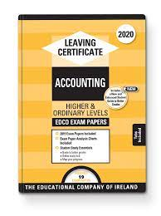
Leaving Certificate Accounting
What is covered? 2 Sections Financial Accounting (Final A/C’s of Sole Traders/Companies, Club/Service Firm A/C’s, Cash Flow Forecasts) 2. Management Accounting (Costing (Product & Marginal) & Budgeting) ➢ Accurate, organised and reasonably good at Maths. ➢ Prepared to be challenged and complete the task.
Examination: Written Exam :100% (3 hrs). All long questions : Marks vary from 60m – 120m (3 Parts) Part 1 & 2 : Financial Accounting Part 3 : Management Accounting
Careers/Courses: Banking, Advertising, Taxation, Secretary, Law, Sales, H.R, Marketing, Insurance.

Slide 34
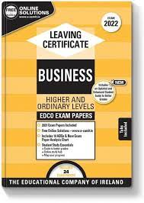
Leaving Certificate Business
What is covered? Unifying Strand: investigating Business Strand 1: Exploring the Business Environment Strand 2: Understanding Enterprise Strand 3: Leading in Business Strand 4: Being Informed & Making Informed Decisions ➢ Business Studies for the Junior Cert is NOT necessary. ➢ Does not contain a lot of accounting (Tax Calculation, Ratio Analysis, B/E charts) ➢ Learning definitions, assessing companies, regulations/legislation and applying knowledge to case studies. ➢ Must like learning things off, but unlike English no essays – bullet point form
Examination: Written Exam: 60% Business Alive Investigative Study: 40%
Careers/Courses: Banking, Advertising, Taxation, Secretary, Law, Sales, H.R, Marketing, Insurance.

Slide 35
Leaving Certificate LCVP Link Modules
LCVP Grade | % score | Points
Distinction | 85-100 | 66
Merit | 65-79 | 46
Pass | 50-64 | 28
What is covered? Strong vocational focus of LCVP through work preparation and enterprise, known as the Link Modules. These subjects teach the skills and knowledge needed to understand how business works. Extra subject not an alternative Leaving Cert Can be counted as one of your six subjects for CAO points NOT MATRICULATION
Assessment: 60% for portfolio (CV, Career Investigation, Summary Report, Enterprise Action Plan, Work Experience, Recorded Interview) 40% for written exam (May) (Enterprise Education and World of Work)
This is a practical subject/programme that suits practical students. It is preparation for the world of work. The majority of marks go for the portfolio which is completed over the 2-years Links with other option subjects which can enhance performance in those subjects. Promotes skills and qualities of self-reliance, innovation and enterprise Skills learned through LCVP such as planning, researching, writing reports and making presentations are keys to your success at third level.
Can NOT be used for Entry Requirements

Slide 36
Remember! YOUR choices may have unintended consequences in 2 years’ time, when paths into college are blocked by unfortunate subject gaps
Familiarise yourself with specific college and course requirements.
Know which subjects are useful/essential for particular courses/careers
Pick subjects you like/are good at to sustain your motivation over two years
There is no such thing as an easy subject in Leaving Cert. All subjects require hard work and effort.
Keeping a science and language subject will increase third level options (even if you have a ‘definite’ career interest)
Don’t leave your decision until the last minute, rushed decisions have costly implications

Slide 37
Who can help decide?
➢ Parents & Guardians Play a major role when it comes to Subject Choice. (ESRI 2011)
➢ Teachers They will discuss what their subject is like at Leaving Certificate Level.
➢ Past Pupils & Older Siblings - ask those who are already studying subjects at senior cycle what they think of them but factor in that everyone has UNIQUE interests and abilities
➢ Guidance Counsellor Make sure to ask questions regarding subjects and future goals.
Examine Subject Textbooks - Exam Papers – www.examinations.ie
www.studyclix.ie

Slide 38
On-Line Research
➢ www.qualifax.ie It gives information on which subjects are needed for what courses, as well as information on all college courses. Look up 'Minimum Entry Requirement' under 'Useful Tools'
https://www.qualifax.ie/index.php?option=com_wrapper&Itemid=26&Mainsec=courses&Subsec=min_courses_select&view=wrapper&xpt=0.61113000%201429190312&xpt=0.87098800%201429191164
➢ www.careersportal.ie Subject information & personal assessments. Also gives information on jobs such as qualifications needed.
https://careersportal.ie/school/subject_explorer.php
Our Borrisokane Community College Career Guidance page: Borrisokane Community College | Guidance & Counselling Website (careersportal.ie)

